Slide 1
Privacy Unaware IoT
Andrew Koenig, Philip Clevenger

Slide 2

Everyday Use
Most of us use IoT devices daily, without realizing the danger they introduce when it comes to privacy and security.
Notes:
Every one of us uses IoT devices every day. Most of them try to make just that little bit easier, or make us feel safer. But what most people don’t realize is that those devices and the apps on them can be a way for an attacker to steal personal information or sensitive data that may make a physical attack much easier.

Slide 3

Problems with Security
Apps given certain permissions may leak information like location data to advertisers or other companies.
Sensitive information stored by an app may not be stored properly, and may appear as plain-text.
Notes:
Most of us, when we install an app, the little screen pops up to give that app certain permissions and we just hit accept without thinking about what we’re doing. Hitting that accept button can let an app get very sensitive data about you and either store it on your device or send it off to some big company that is going to make a bunch of money off of you by selling it to an advertiser.

Slide 4
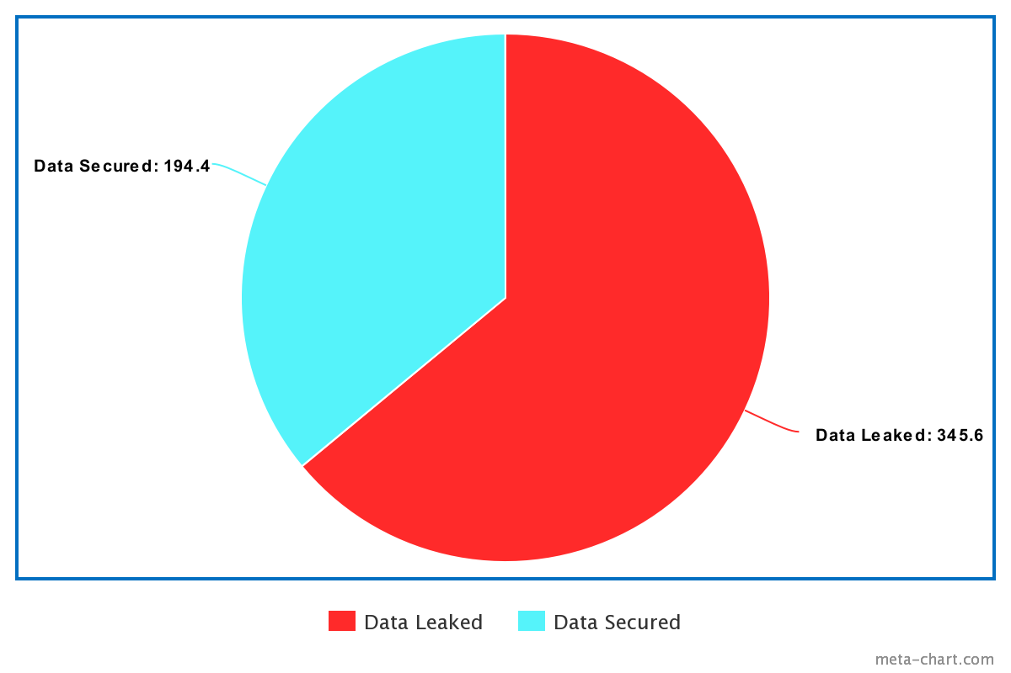
Problems with Privacy
A study conducted on 540 IoT related apps showed 64% of them leaked sensitive information to an external source.
From: “Analysis of Privacy-(un)aware IoT Applications”
Notes:
A study conducted on 540 different IoT applications showed that 64% of them sent sensitive information to an external source. This can be location data, what you watch on your phone, who you talk to, what you’re doing, or anything that you allowed when you hit that accept button.

Slide 5

Data Storage
Data collected by these apps may not immediately be sent to an external source, but it might still be stored on the device in a plain-text format.
Notes:
Not all of the data collected is useful to an advertising agency or any big company. But that doesn’t mean that data should be kept unsecure. Sensitive information like if your front door, or garage door is open might be stored in “plain-text” on your device, and be easily accessible by someone that knows what they’re doing. This is a problem with apps that connect you to a home security system.

Slide 6
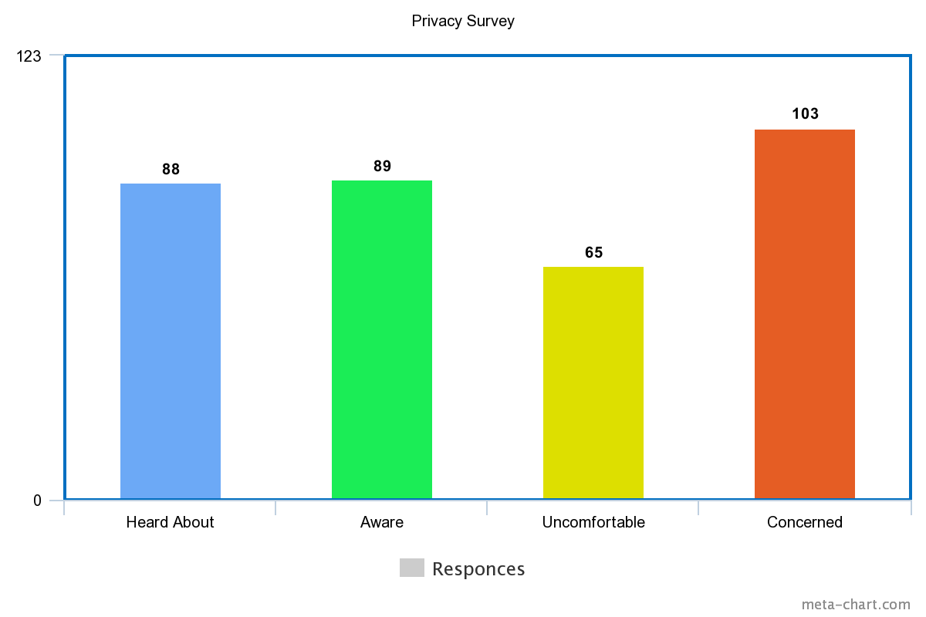
Privacy concerns
How do people feel about their privacy on the internet?
103 are concerned
65 are uncomfortable
89 are aware
88 have heard about it
From: “Analysis of Privacy-(un)aware IoT Applications”

Slide 7
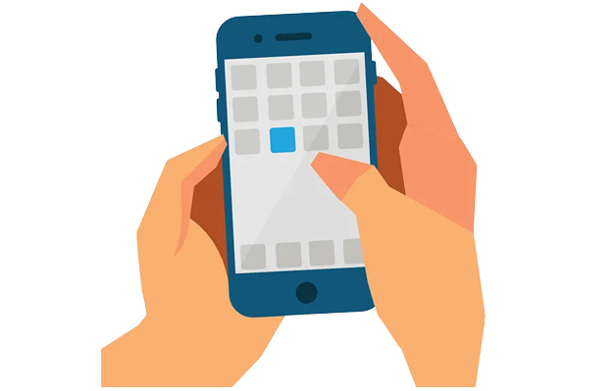
IoTWatch
IoTWatch is an app created to monitor the data being collected or stored by other apps. It also notifies users when an app uses information that it should not.

Slide 8
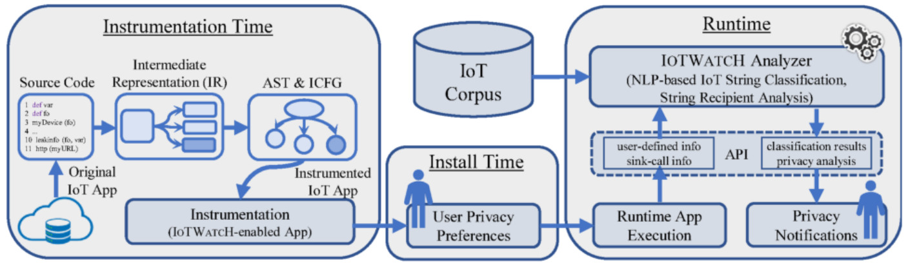
How it works
IoTWatch injects its own code into the chosen app, and allows the user to create their own privacy settings for the specified app.

Slide 9
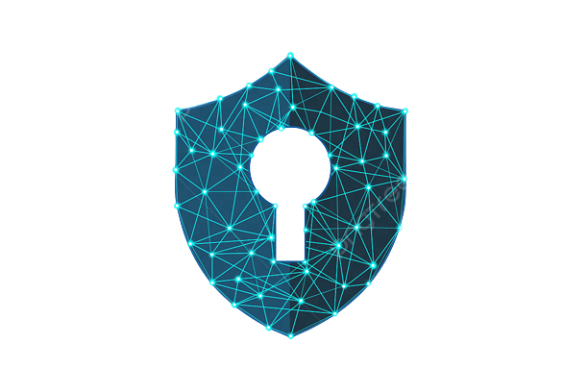
Delicate Balance
You can't always have the perfect balance of security, and usability. Each of us has to decide where we draw the line on our privacy.

Slide 10
Conclusion
We give IoT apps access to a lot of sensitive information, sometimes without realizing. It is important to know where your data goes, and who can see it.

